Slide 1
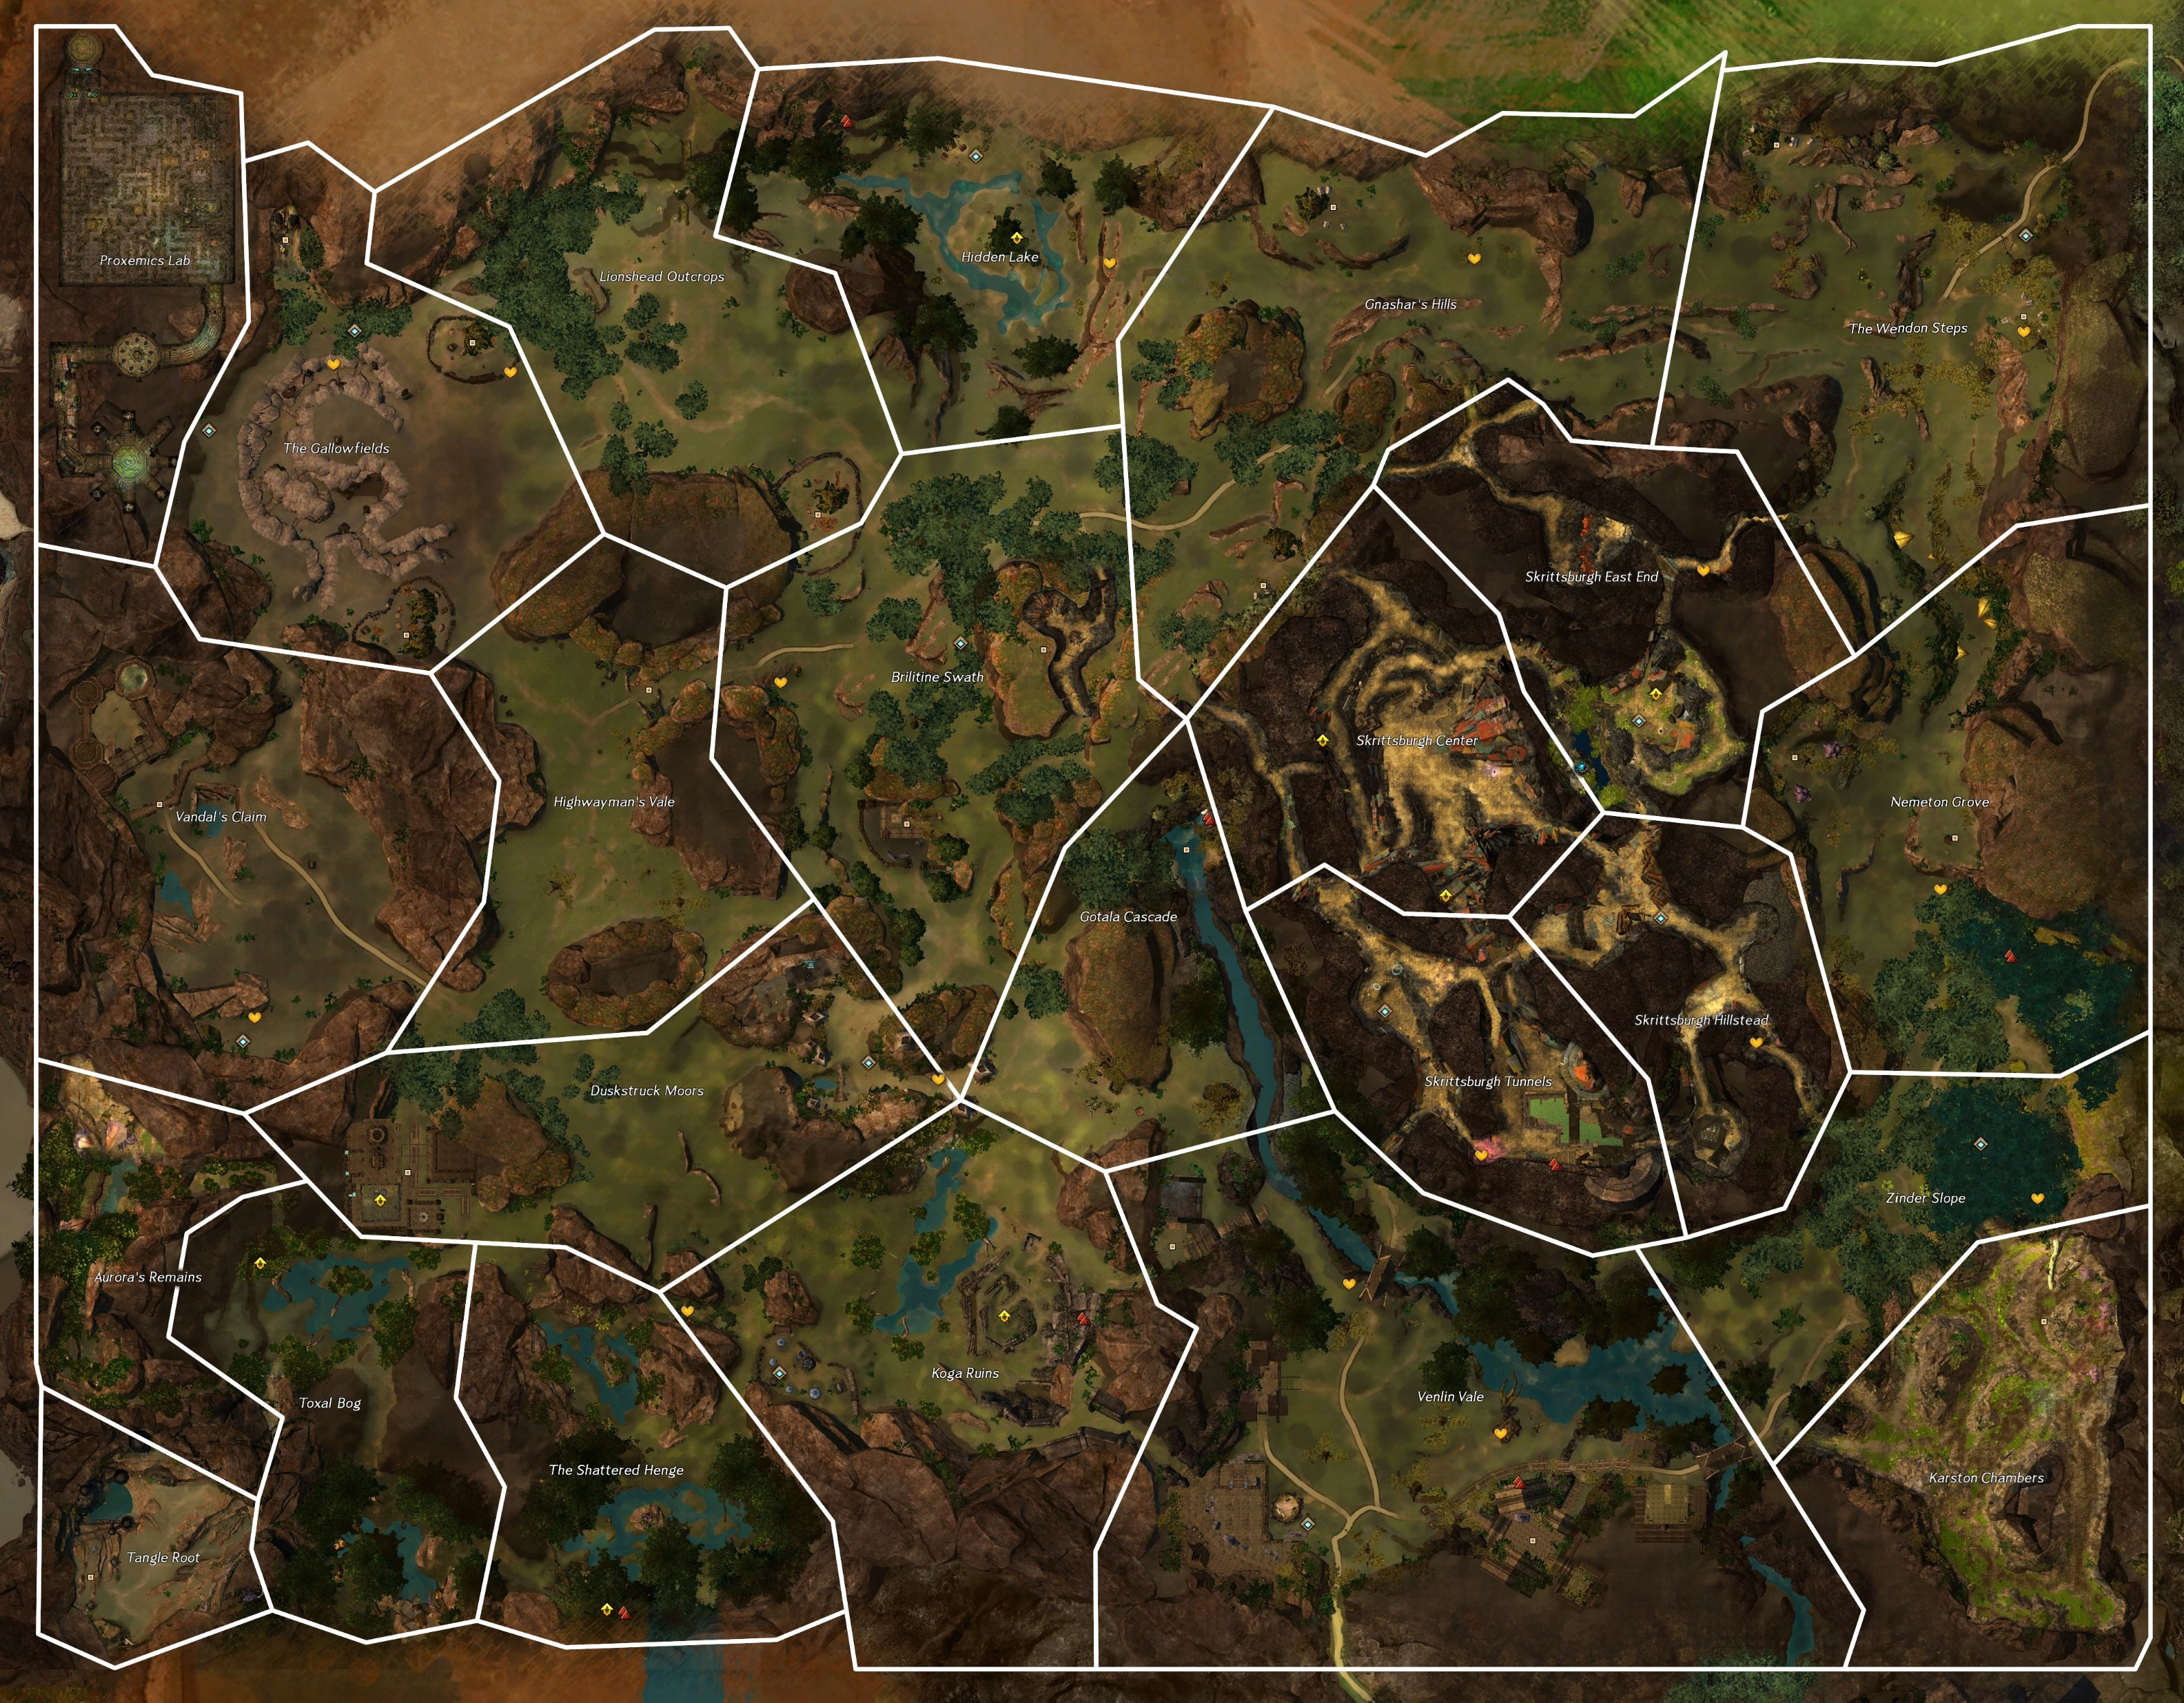
1-welcome inventor
2-brain washing
3-interrupting research
4-not even the frogs are safe, note about fun house
5-plot to disrupt power to metrica
6-too busy with the rats
7-zojja drops in to send a message, pick up a crafting profesion. She heard from a frog about a hidden entrance. Go ask for more details
8-frogs talk about how hunters north of anthill report inquest disappear into the wall
9-assault the complex to see about notes on the power grid plan
10-find hologram of assault plan, return and head over to luminates plant
11-keep powergid safe
12-turrets online, inquest complex to north threatens
13-recover note mentioning thaumanuova
14-stolen core taken north, theft covered up by toxins from failed experiment
17-fast travel
1-zojja-
19
20
21
9
6
8
5
10
7
18
11
4
18
18
3
17
3
3
16
12
2
15
2
1
13
1
14

Slide 2
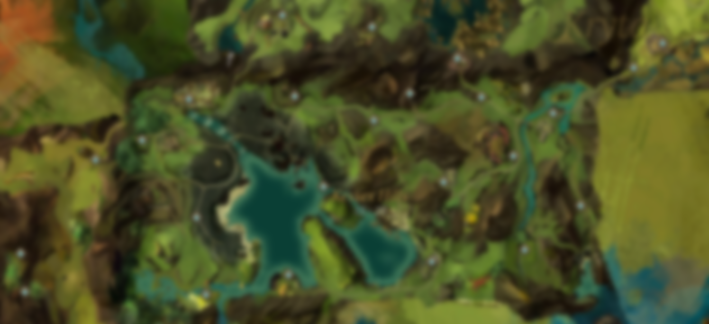

Gendarran Fields

Slide 3

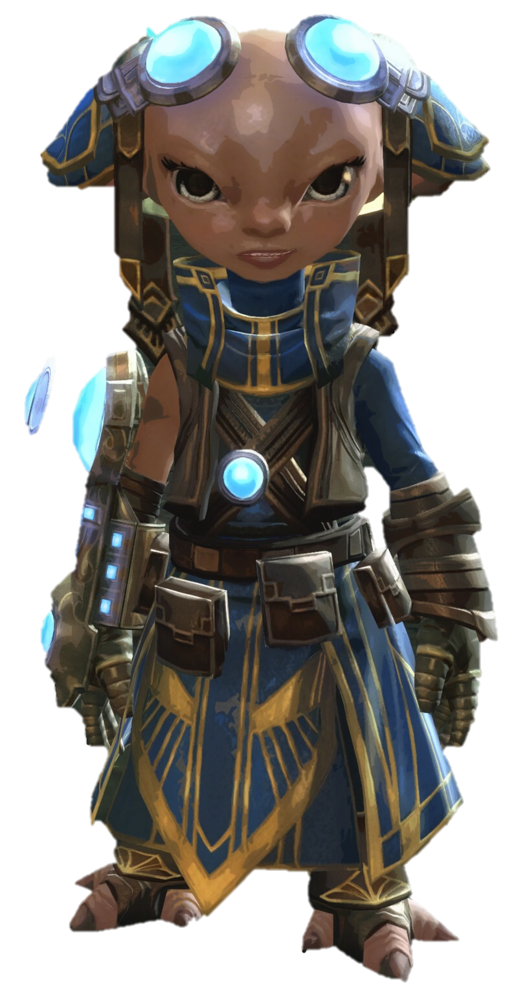
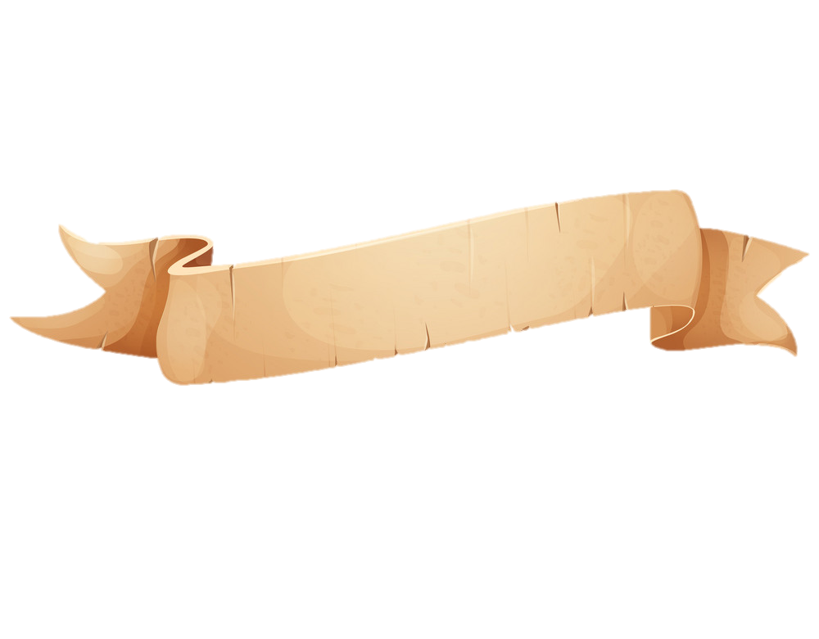
Text
text.
1
Zojja

Slide 4
text.
text.
Text
text.
1
2

Slide 5
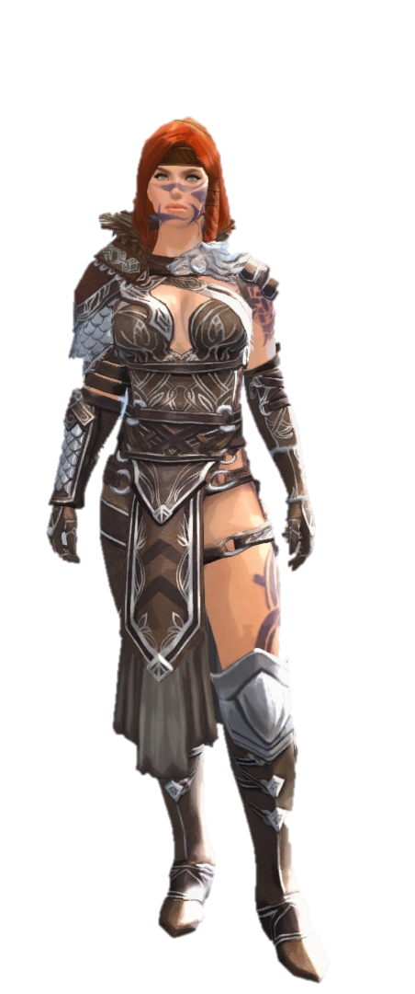
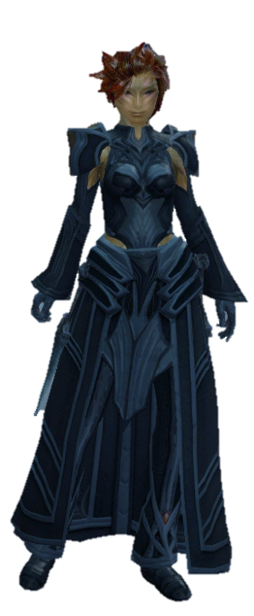

Slide 6
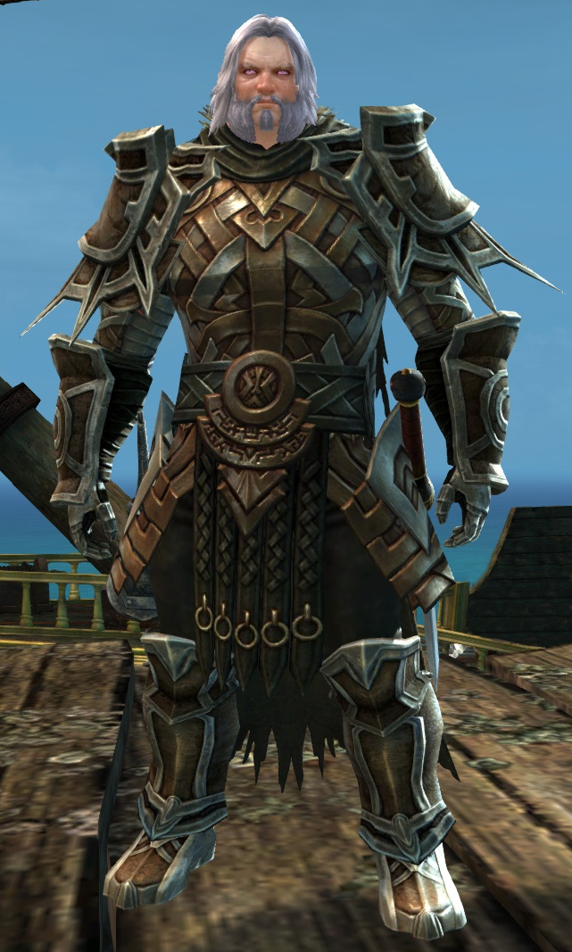

Slide 7
